Slide 1
PROJECT EXHIBITION -3

Slide 2
PROJECT TITLE
DIABETIC RETINOPATHY

Slide 3
PROJECT GUIDE
DR. GOPAL SINGH TANDEL
Group-22
TEAM MEMBERS
PRASANAJEET OJHA
ADITYA NARAYAN JHA
NAVANIL DAS
ISHA CHOUDHARY
TANMAY SRIVASTAV

Slide 4
TABLE OF CONTENTS:-
INTRODUCTION
EXSISTING WORK WITH LIMIATATION
PROPOSED WORK WITH METHDOLOGY
NOVELTY OF PROJECT
REAL TIME USAGE
HARDWARE AND SOFTWARE REQUIREMENTS
OVERALL SYSTEM ARCHITECTURE
LITERATURE REVIEW
MODULE DESCRIPTION
MODULE WORK FLOW EXPLANATION
IMPLEMENTATION AND CODING
SNAP SHOT OF PROJECT
TESTING
RESULT AND DISCUSSION
CONCLUSION

Slide 5
INTRODUCTION
Imagine a condition that silently threatens the vision of millions.
In the world of healthcare, such a condition exists, and it's called Diabetic Retinopathy.
Diabetic retinopathy is a diabetes-related eye condition that damages the retina, potentially leading to vision loss or blindness. It is caused by damage to blood vessels in the retina due to high blood sugar levels
.Diabetic retinopathy is the major ocular complication of diabetes mellitus, and occurs in about 30 to 40% of diabetic individuals .
According to the World Health Organization (WHO), an estimated 463 million adults worldwide were living with diabetes in 2019, with this number projected to increase to 700 million by 2045
In 2020, the International Diabetes Federation (IDF) reported that one in three adults with diabetes is at risk of developing Diabetic Retinopathy.

Slide 6
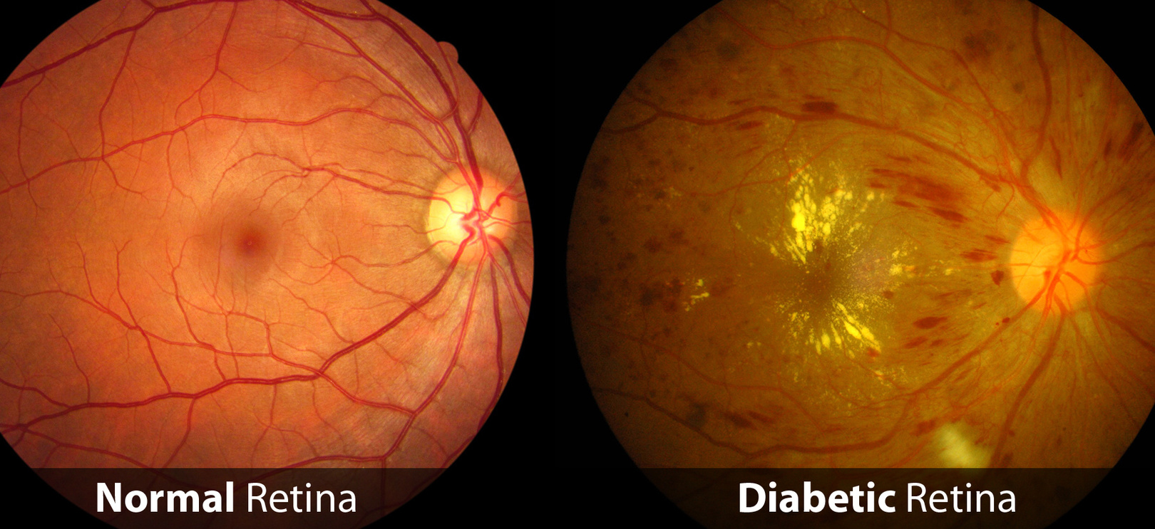
Behind these statistics lies the stark reality of Diabetic Retinopathy's severity, as it silently erodes vision and quality of life for million.
Notice the stark contrast between a healthy, functioning retina and one affected by Diabetic Retinopathy, underscoring the critical importance of early detection and intervention

Slide 7
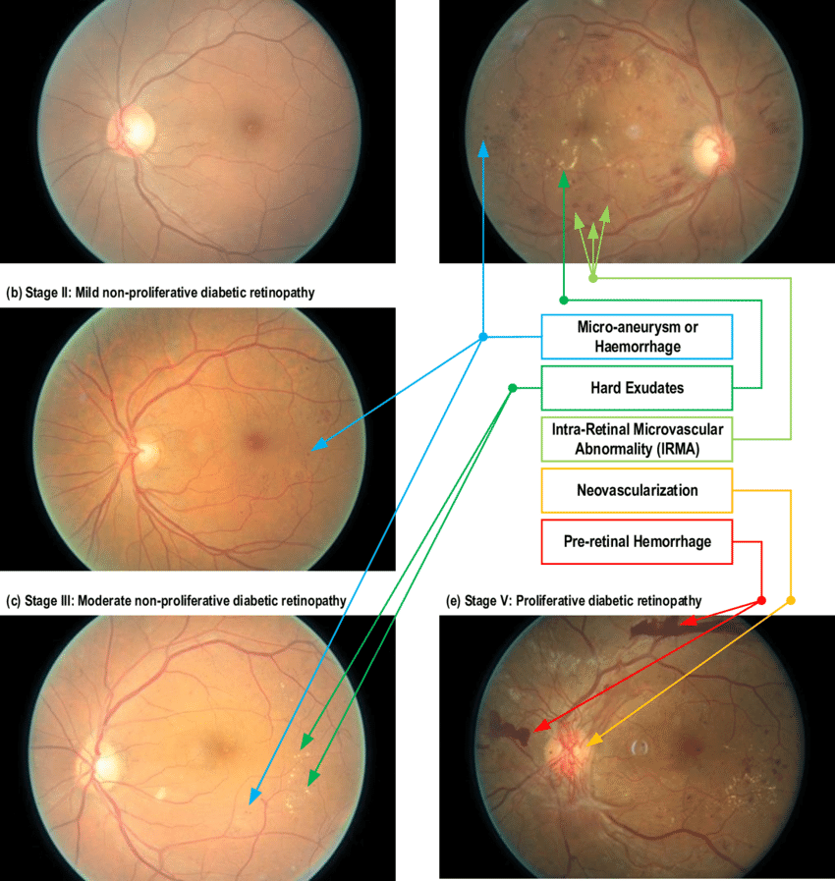
Differences between all types of Diabetes Retinopathy

Slide 8
EXSISTING WORK WITH LIMITATION
1.IDx-DR System:
Limitation: While the IDx-DR System was one of the first FDA-approved AI systems for autonomous diagnostic use, its deployment in real-world clinical settings and the cost of implementation may be limiting factors for broader adoption.
2.Google's DeepMind Health:
Limitation: The use of deep learning for diabetic retinopathy detection by DeepMind Health has shown promise, but the limited interpretability of deep learning models remains a challenge for clinical acceptance and trust.
3.EyeArt AI System:
Limitation: Similar to other AI-based systems, the EyeArt AI System may not address the issue of model interpretability, making it challenging to explain model decisions.
4.Aravind Eye Hospital Projects:
Limitation: Projects like those at Aravind Eye Hospital have primarily focused on resource-constrained settings, which may not fully address the scalability and integration challenges of AI-based solutions in developed healthcare systems.

Slide 9
PROPOSED WORK
Our proposed work centers around improving the accuracy of diabetes retinopathy image classification through a comprehensive approach. We have systematically investigated three distinct pre-processing techniques: Gaussian filtering, CLAHE filtering with ESRAGN, and no filtering, with a focus on understanding their impact on classification performance. To evaluate these techniques, we employed a variety of deep learning models, including ResNet101, ResNet50v2, InceptionV3, InceptionV2, EfficientNetB4 and InceptionResNetV2 .
Our primary goal is to identify the most effective combination of pre-processing and model architecture that maximizes the accuracy of diabetic retinopathy image classification (Which we found was Efficient Net B4). We also plan to apply Feature Fusion and Feature Extraction to enhance the result. This research holds significant potential in improving the early detection and diagnosis of diabetes-related eye diseases, ultimately benefiting patients and healthcare providers alike. By presenting our findings, we aim to provide valuable insights into the optimal strategies for handling medical image data and guide future work in this critical area of medical image analysis.

Slide 10
NOVELTY OF PROJECT
1. Comprehensive Model Comparison:
Novelty: Unlike many existing works, we conduct an extensive comparative analysis of deep learning models, including EfficientNet B4, ResNet101, and others. This comprehensive approach enables us to identify the most effective model for early detection, enhancing accuracy and reliability.
2. Improved Model Interpretability:
Novelty: We place a strong emphasis on improving the interpretability of our deep learning models. By incorporating explainable AI techniques, we make our models more transparent, allowing healthcare practitioners to better understand diagnostic decisions.
3. Real-World Applicability:
Novelty: Our project focuses on addressing the challenges of real-world clinical implementation. We work on integrating our solution into existing healthcare systems and adapting to clinical workflows, bridging the gap between research and practice.
4. Scalability Considerations:
Novelty: We are attentive to the scalability of our solution, ensuring that it can be deployed in resource-constrained healthcare environments, making it accessible to a wider range of healthcare facilities.
5. Diverse Dataset Utilization:
Novelty: We curate and work with diverse datasets, enabling our models to generalize well to different patient populations and reducing the risk of bias towards specific demographic groups.

Slide 11


Real Time Usage
The real-time usage of our diabetes retinopathy image classification project is tremendously valuable for the medical field and healthcare providers. Here's how it can be applied:
Early Diagnosis and Intervention: Our model's accuracy in classifying retinopathy images can assist healthcare professionals in identifying the disease at its earliest stages. Early diagnosis allows for timely intervention and treatment, potentially preventing or minimizing vision loss among diabetic patients.
Screening Programs: Our system can be integrated into screening programs, especially in areas with limited access to specialized eye care. It enables the automation of initial screenings, reducing the burden on healthcare personnel and making screenings more accessible.

Slide 12
Telemedicine: In the era of telemedicine, your model can be incorporated into telehealth platforms, allowing patients to upload retinopathy images for remote diagnosis. This enhances the reach of medical expertise and enables diabetic individuals to receive prompt feedback and guidance from healthcare providers.
Integration with Web Application (Future Development): Creating a user-friendly web interface to interact with your diabetes retinopathy image classification system makes it accessible to a broader audience

Slide 13
Hardware and Software used
HARDWARE REQUIRED
LAPTOP WITH MINIMUM 8GB RAM
MINIMUM 4GB OF DEDICATED GRAPHICS CARD
SOFTWARE REQUIRED
KAGGLE
PYTHON AS LANGUAGE
DEEP LEARNING FRAMEWORKS (TENSORFLOW,PYTORCH)
IMAGE PROCESSING LIBRARIES(OPEN CV)

Slide 14
SYSTEM ARCHITECTURE
Data Preprocessing and Data Augmentation
Making 5 folds for 5 cross validation
Pre-trained models
(EfficientNet b4)
Dataset Finalizing

Slide 15
SYSTEM ARCHITECTURE
Fusing all features using feature fusion
Extracting features with PCA
Model evaluation
Increase in accuracy

Slide 16
LITERATURE REVIEW
Firstly the research paper https://doi.org/10.3390/healthcare11060863 purposes Deep learning model for diagnosing the five stages of diabetic retinopathy using APTOS dataset.They have two dataset for their model (normal dataset and dataset on which image enhancement is done using Clahe and ESRGAN). The researchers then trained both the datasets on Inception V3 and found that the accuracy for normal dataset was 80.87% whereas the accuracy for image enhanced dataset was 98.7%. This proposed system was evaluated using many indicators such as accuracy ,confusion matrix ,precision ,recall,top n frequency and F-1 score. The model achieved an accuracy of 98.71% in the dataset with image enhancement techniques and 80.87% in the dataset without image enhancement .

Slide 17
LITERATURE REVIEW
The researchers of https://www.sciencedirect.com/science/article/pii/S0045790618302556 took their dataset from kaggle .Their dataset consisted of high resolution eye images that was graded by professionals in 5 classes .Theresearchers then performed image pre-processing. After this several CNN architectures like AlexNet, VggNet , GoogleNet , ResNet were for training the dataset. AlexNet received an accuracy of 89.75%. The Vgg-16 ,GoogleNet and ResNet respectively received accuracy of 93.17% ,93.36% and 90.40% respectively.

Slide 18
LITERATURE REVIEW
The researchers of https://www.sciencedirect.com/science/article/pii/S2666307423000050#fig0006 selected a dataset which consists of 1444 fundus images out of which about 50% images were those images that don't have diabetes retinopathy. Then the researchers performed data preprocessing under which image quality assessment ,annotation ,imbalance handling and data restructuring took place.Then the data augmentation was performed on the dataset under which CLAHE filter was also applied on the dataset. Then the dataset was trained on different models like SqueezeNet ,Resnet50 ,ResNet152 and DenseNet201 was used for training the dataset. The accuracy of ResNet 50 was 93.67% , ResNet 152 was 94.40% and SqueezeNet 1 was 91.94%. Then after this the researchers chose the best model in terms of accuracy and applied feature extraction on that model . Then Multi -Label Feature Extraction and Classification was applied to enhance the result.

Slide 19
LITERATURE REVIEW
The researchers of https://doi.org/10.3390/s23125726 selected the APTOS 2019 Blindness detection dataset.The dataset consist of 3662 retinal images.This dataset was divided into five classes according to severity of DR.The researchers used dataset balancing techniques on their dataset as part of image preprocessing. Balancing of the dataset was done by adjusting the ratios to minimize the disparities between classes. Then image preprocessing was performed under which resizing, gaussian blur, ben graham approach and then cropping to the region of interest was performed to ensure improved image quality.Then the datasetwas divided into training and testing dataset with 80% images for training and 20% images for testing. The dataset was trained on two models .First dataset was trained on a hybrid model that consists of VGG16 with XGBoost Classifier , the hybrid model achieved an accuracy of 80% Secondly the dataset was trained on the DenseNet 121 model , this model achieved the accuracy of 97.30%.

Slide 20
MODULE DESCRIPTION
1. Dataset Finalizing:
Purpose: This module focuses on curating and finalizing the dataset for model training and validation.
Tasks: Data collection, annotation, and ensuring data quality and diversity.
2. Data Preprocessing and Data Augmentation:
Purpose: To prepare the dataset for model training by ensuring consistency and enhancing model robustness.
Tasks: Image resizing, normalization, and applying data augmentation techniques to increase dataset size and diversity.
3. Making 5 Folds for 5-Fold Cross-Validation:
Purpose: Preparing the data for cross-validation to evaluate model performance robustly.
Tasks: Splitting the dataset into five folds for cross-validation, ensuring balanced class distribution in each fold.
4. Pre-trained Models (EfficientNet B4):
Purpose: Selecting the most effective model architecture for the task of diabetic retinopathy detection.
Tasks: Training, fine-tuning, and validation of deep learning models, with EfficientNet B4 emerging as the most efficient choice.

Slide 21
5. Extracting Features with PCA:
Purpose: Reducing feature dimensionality while retaining relevant information.
Tasks: Principal Component Analysis (PCA) applied to extracted features for dimensionality reduction.
6. Fusing All Features Using Feature Fusion:
Purpose: Combining the reduced features to create a comprehensive feature representation.
Tasks: Implementing feature fusion techniques to capture the rich information from each feature set.
7. Model Evaluation:
Purpose: Rigorous evaluation of the models' performance in detecting diabetic retinopathy.
Tasks: Cross-validation testing, performance metric computation, and ROC analysis to assess diagnostic accuracy.
8. Increasing Accuracy:
Purpose: Enhancing the model's accuracy and reliability.
Tasks: Fine-tuning hyperparameters, optimizing model architecture, and implementing post-processing techniques.

Slide 22
MODULE WORK FLOW EXPLANATION
1. Dataset Finalizing:
Data Collection: We begin by collecting a diverse and representative dataset of retinal images, ensuring that it covers a wide range of cases.
Data Annotation: Each image is carefully annotated to label the severity of diabetic retinopathy, creating a labeled dataset for model training and validation.
Data Quality Check: A thorough quality check is conducted to remove any irrelevant or low-quality images.
2. Data Preprocessing and Data Augmentation:
Data Preparation: The dataset is preprocessed to standardize image dimensions, format, and color spaces, ensuring consistency for model training.
Data Augmentation: We apply data augmentation techniques to enhance the dataset by introducing variations in lighting, rotation, and scaling, increasing model robustness.

Slide 23
3. Making 5 Folds for 5-Fold Cross-Validation:
Dataset Splitting: We divide the dataset into five roughly equal subsets (folds) to enable 5-fold cross-validation. This ensures robust model evaluation.
Balanced Class Distribution: Each fold is carefully structured to maintain a balanced distribution of different severity levels of diabetic retinopathy.
4. Pre-trained Models (EfficientNet B4):
Model Selection: Among the various deep learning models considered, EfficientNet B4 stands out as the most efficient and promising choice for diabetic retinopathy detection.
Training and Fine-Tuning: The selected model undergoes training and fine-tuning with the preprocessed and augmented data to improve its performance.
5. Extracting Features with PCA:
Dimensionality Reduction: Principal Component Analysis (PCA) is applied to the features extracted from the retinal images, reducing their dimensionality while retaining the most significant information.

Slide 24
6. Fusing All Features Using Feature Fusion:
Feature Integration: We combine the reduced features from different sources using feature fusion techniques. This fusion captures a broader range of information.
Comprehensive Feature Set: The fused features create a more comprehensive and informative feature representation for diabetic retinopathy detection.
7. Model Evaluation:
Cross-Validation Testing: The models are rigorously evaluated using 5-fold cross-validation, which ensures robustness and generalizability.
Performance Metrics: We compute performance metrics such as accuracy, sensitivity, specificity, and ROC curves to assess the model's diagnostic accuracy.
8. Increasing Accuracy:
Model Refinement: Fine-tuning and optimization techniques are employed to increase the model's accuracy and reliability.
Post-processing: Further post-processing methods may be applied to refine the model's predictions.

Slide 25
Implementation and Coding
https://www.kaggle.com/datasets/prasannajeetojha/diabetes-retinopathy-g

Slide 26
TESTING
InceptionRestNetV2- 81%
RestNet101 - 78%
vgg16 - 80%
EfficientNetB4- 84.02%
InceptionV3 - 76%
RestNet50 - 78%
We tested on several models and and found EfficientNetB4 to be the best suitable Deep Learning model as of now

Slide 27
RESULT AND DISCUSSION
After choosing the model:
We tried different variations with our model, like:
Batch size 10
Batch size 30
Epochs is 100 in every batch size
Now we got some pattern and results , they are in following slides

Slide 28
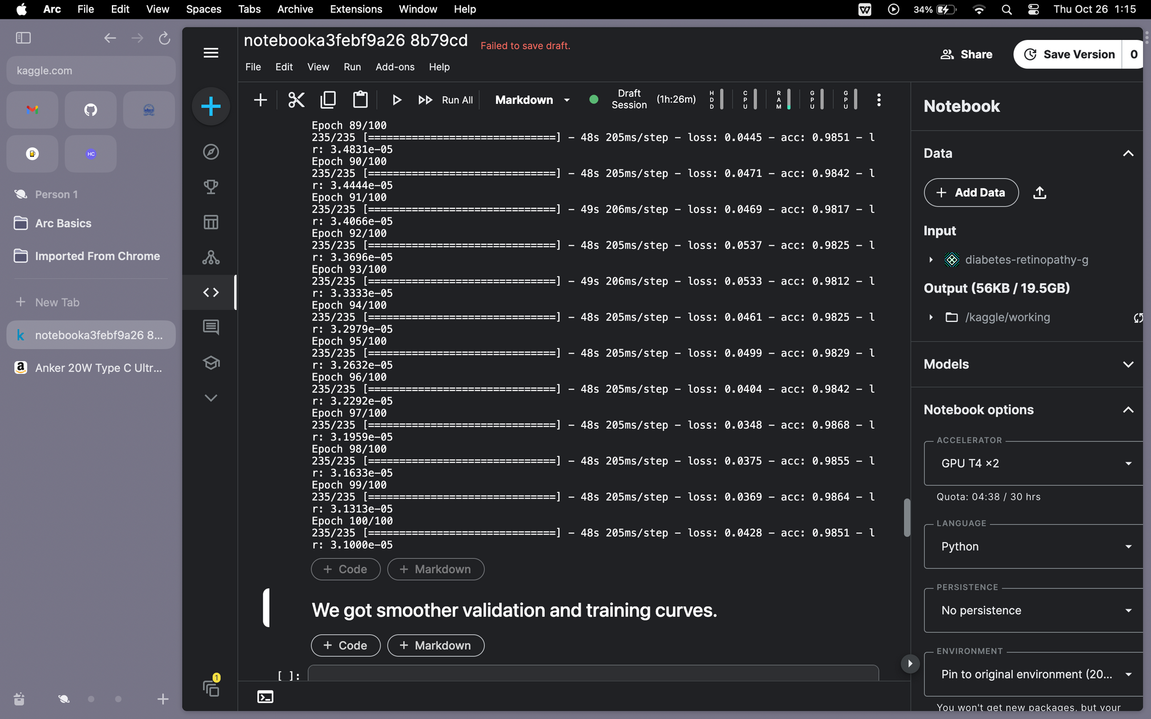
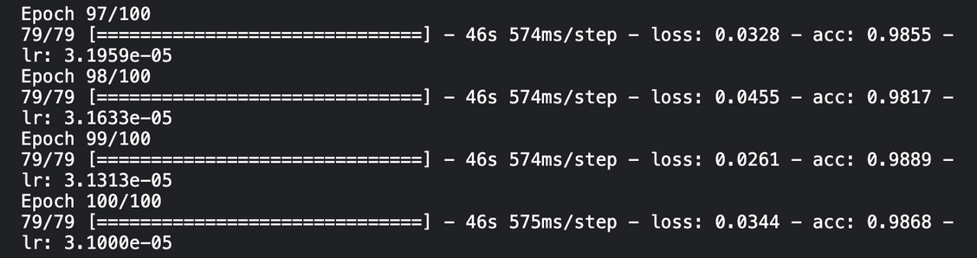
RESULT AND DISCUSSION
Batch size = 10
Batch size = 30
Test accuracy

Slide 29
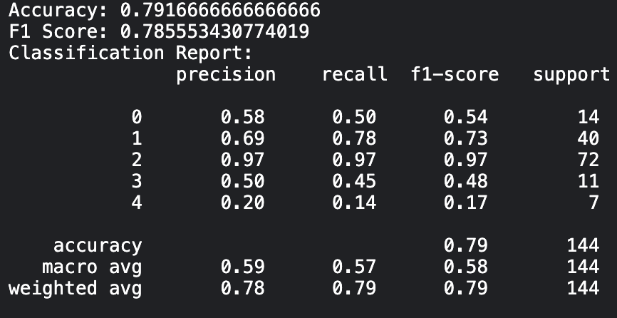
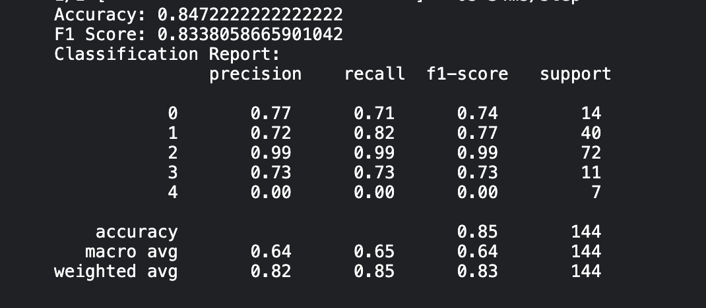
RESULT AND DISCUSSION
Batch size = 10
Batch size = 30
F1 Score

Slide 30
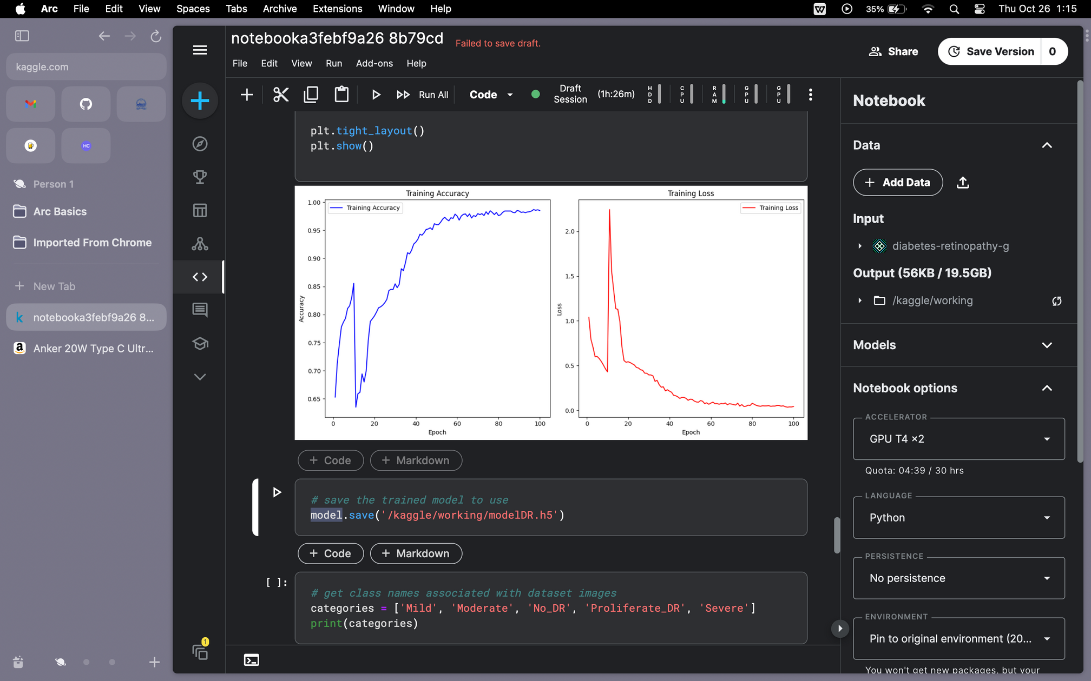
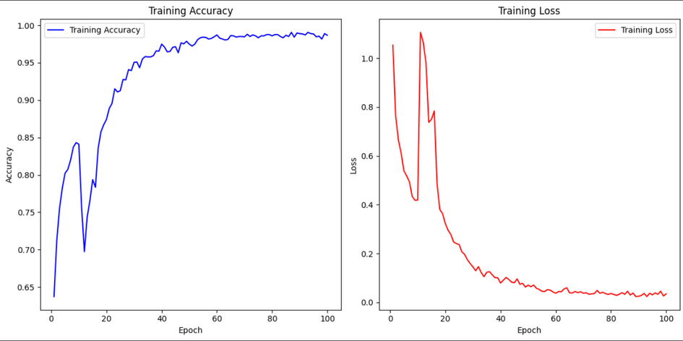
RESULT AND DISCUSSION
Batch size = 10
Batch size = 30
Training and loss graph

Slide 31
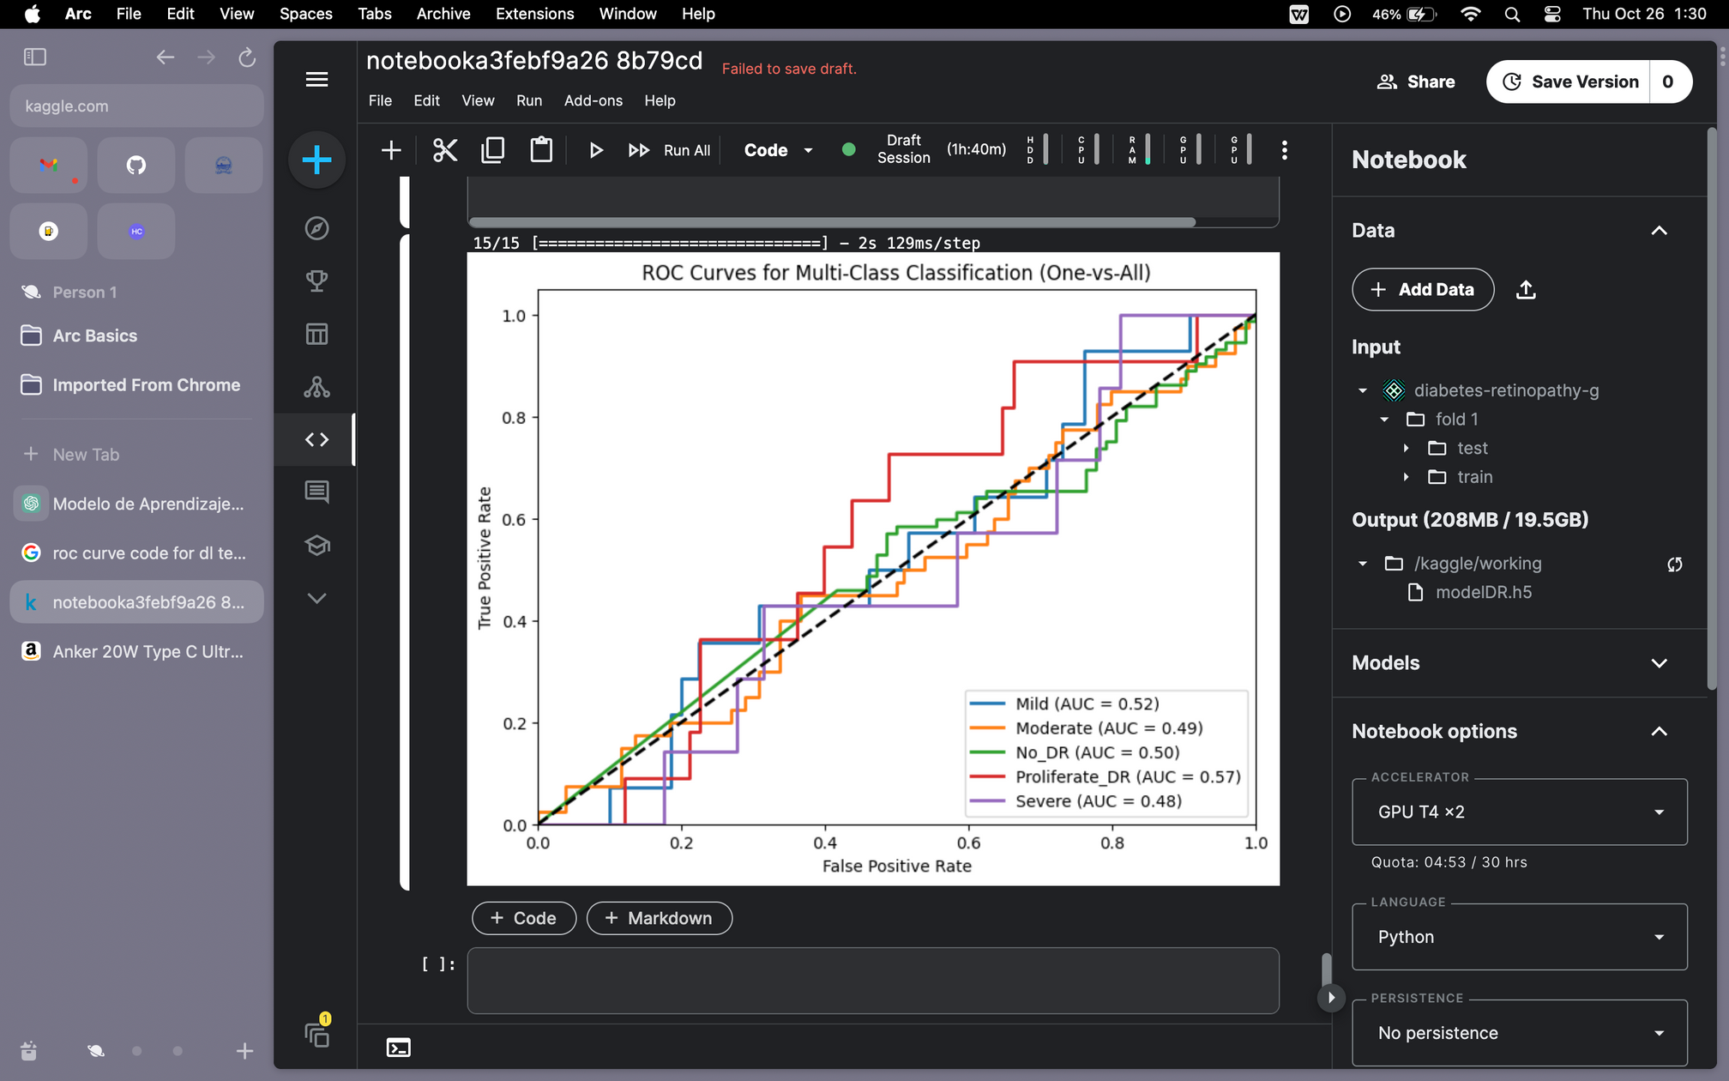
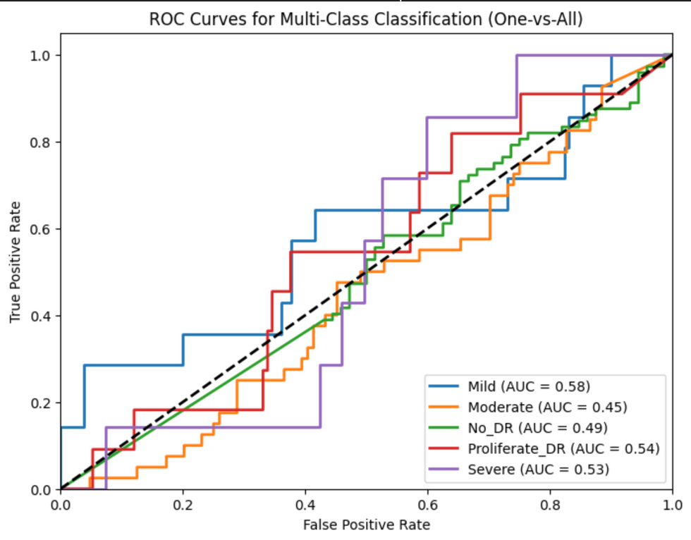
RESULT AND DISCUSSION
Batch size = 10
Batch size = 30
ROC Curves

Slide 32
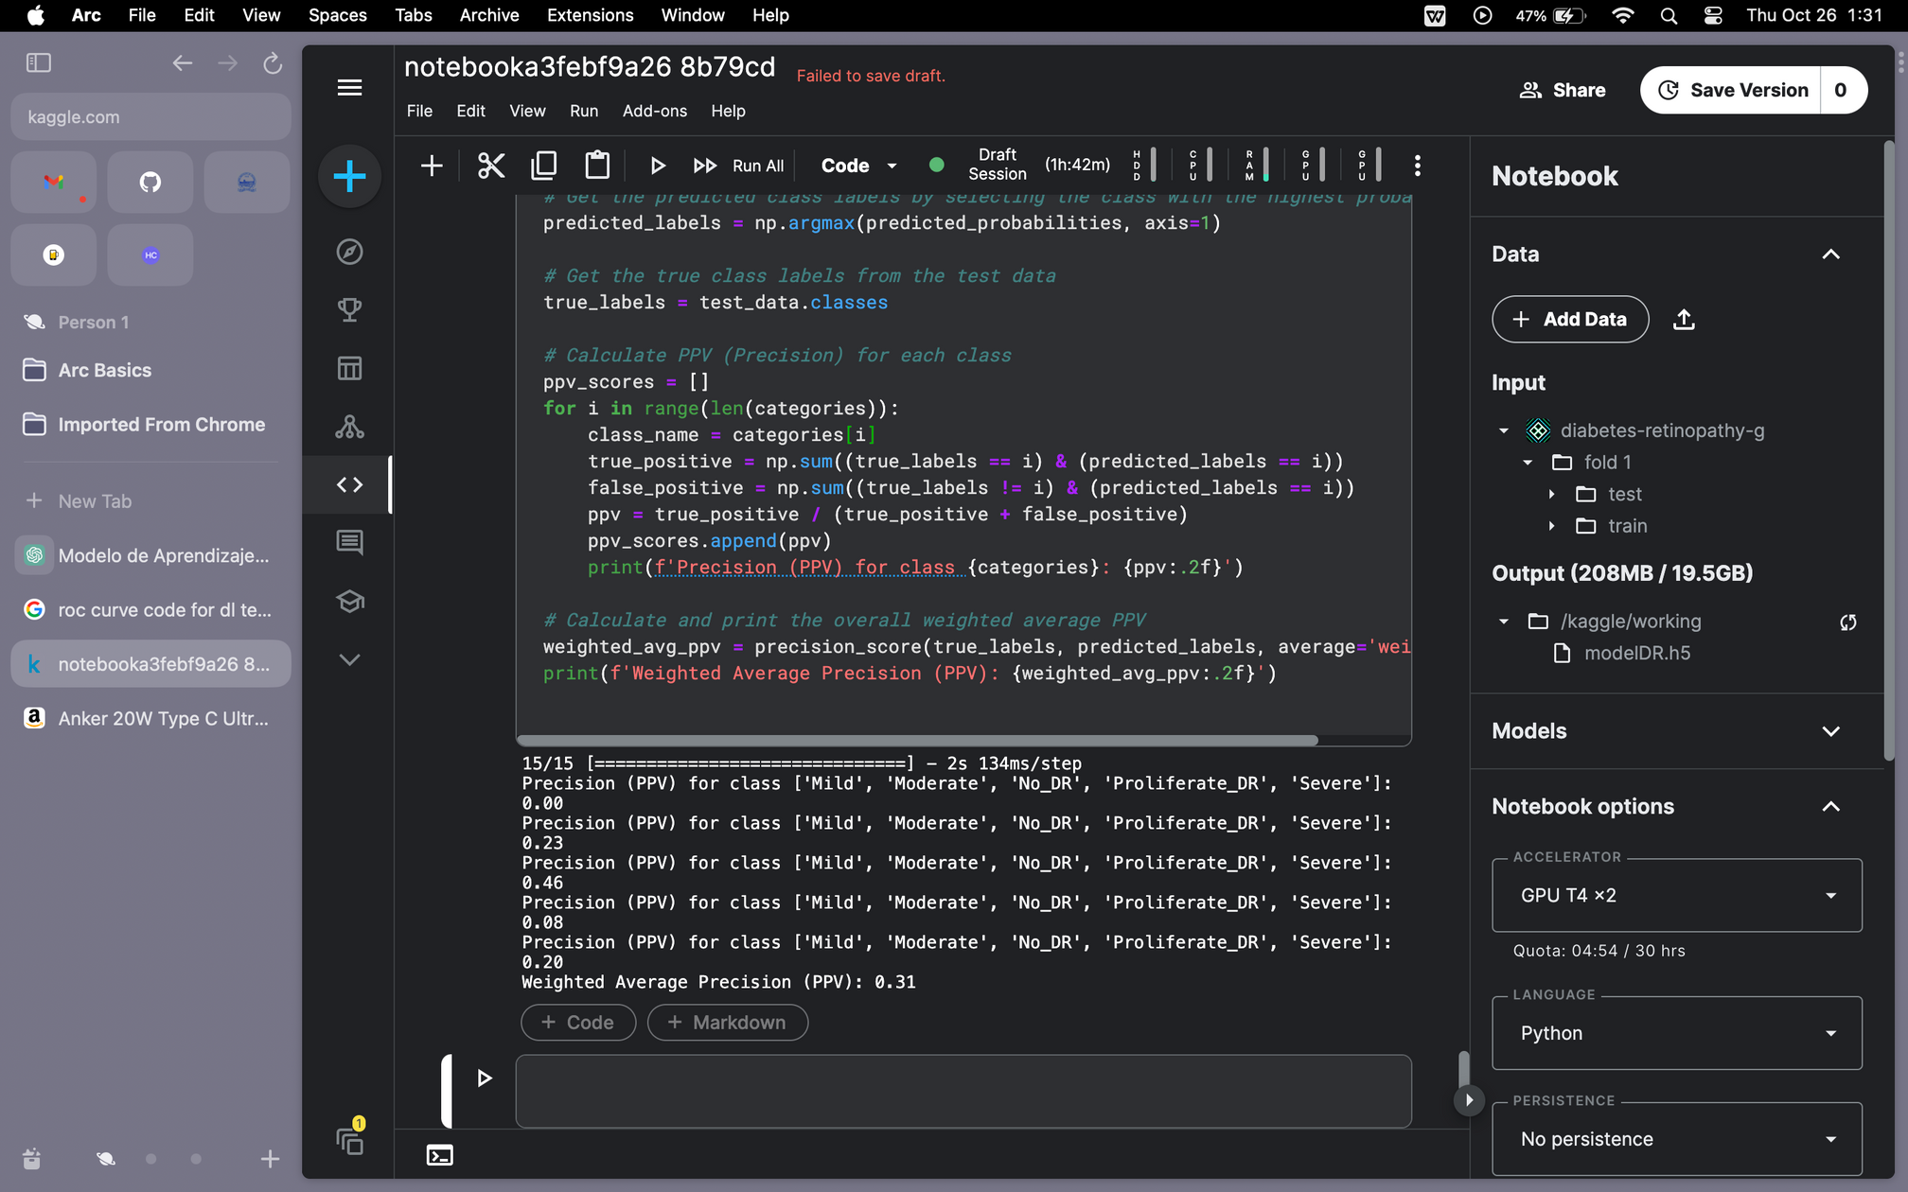
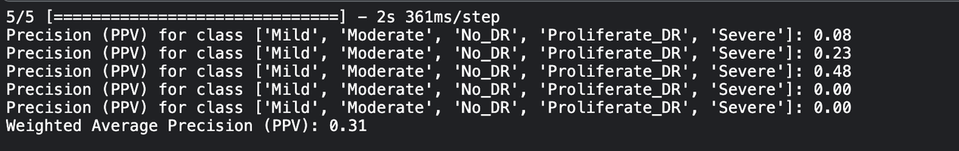
RESULT AND DISCUSSION
Batch size = 10
Batch size = 30
Positive Predictive Value

Slide 33
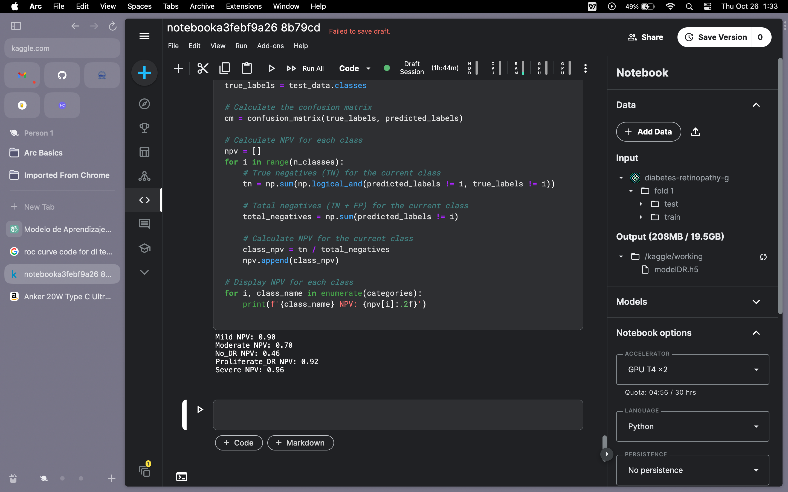
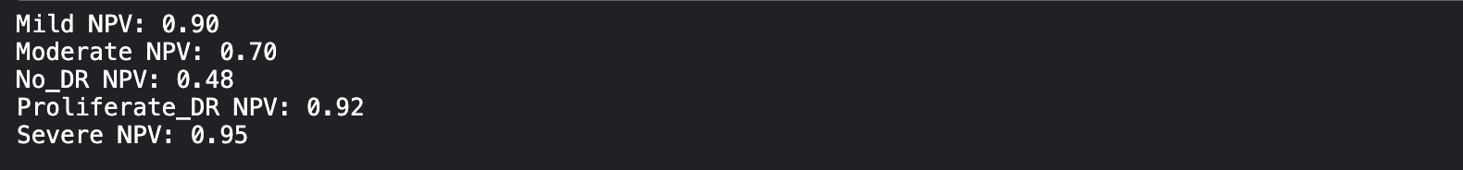
RESULT AND DISCUSSION
Batch size = 10
Batch size = 30
Negative Predictive value

Slide 34
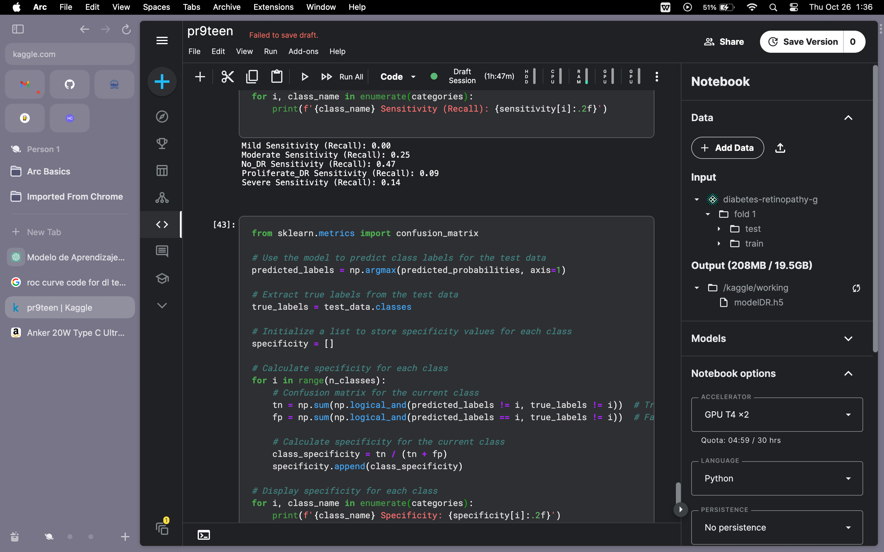
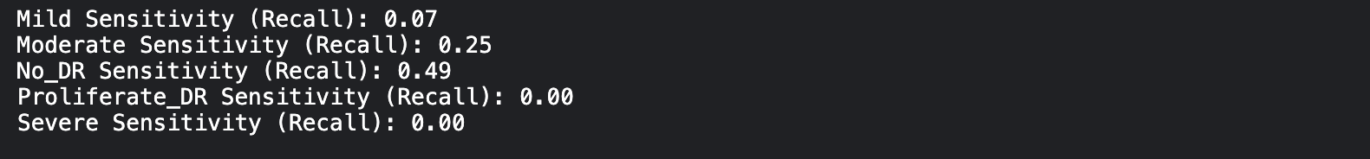
RESULT AND DISCUSSION
Batch size = 10
Batch size = 30
Sensitivity

Slide 35
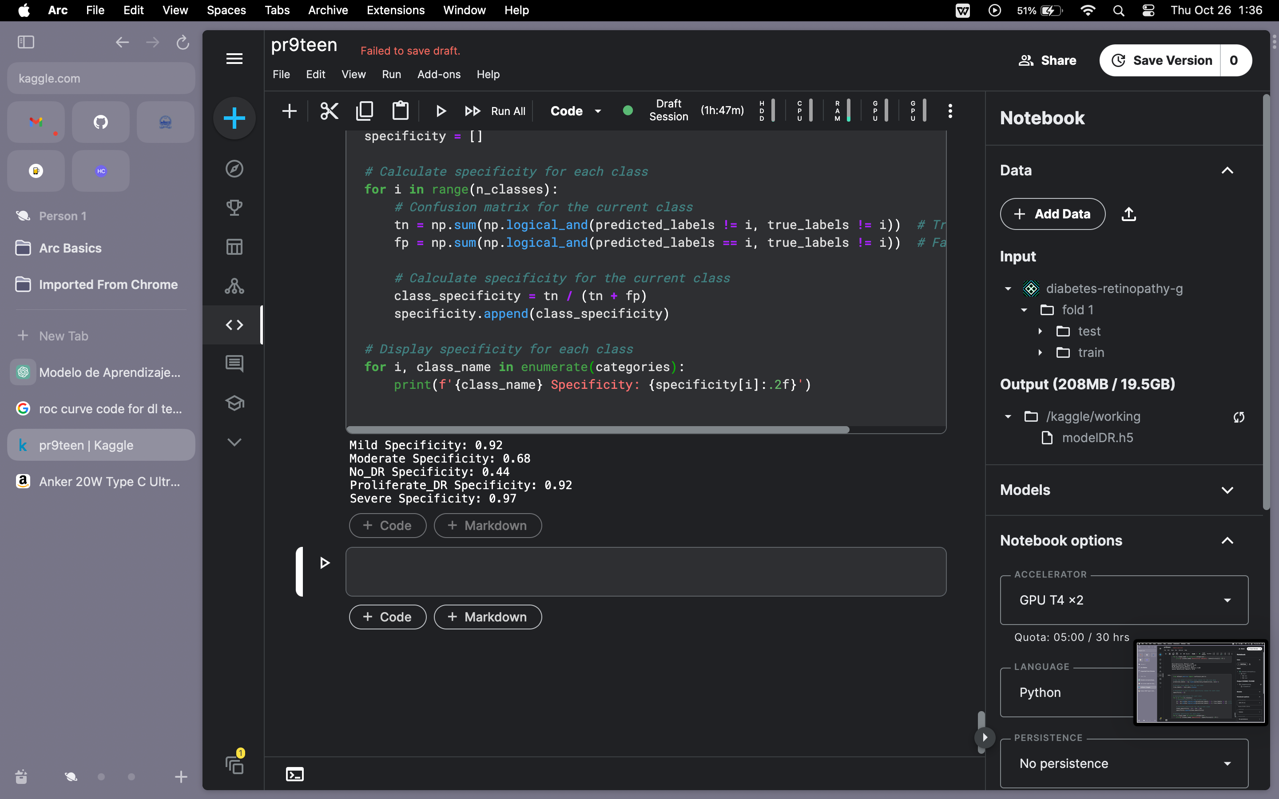
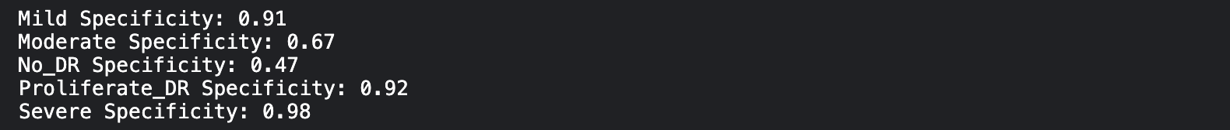
RESULT AND DISCUSSION
Batch size = 10
Batch size = 30
Specificity

Slide 36
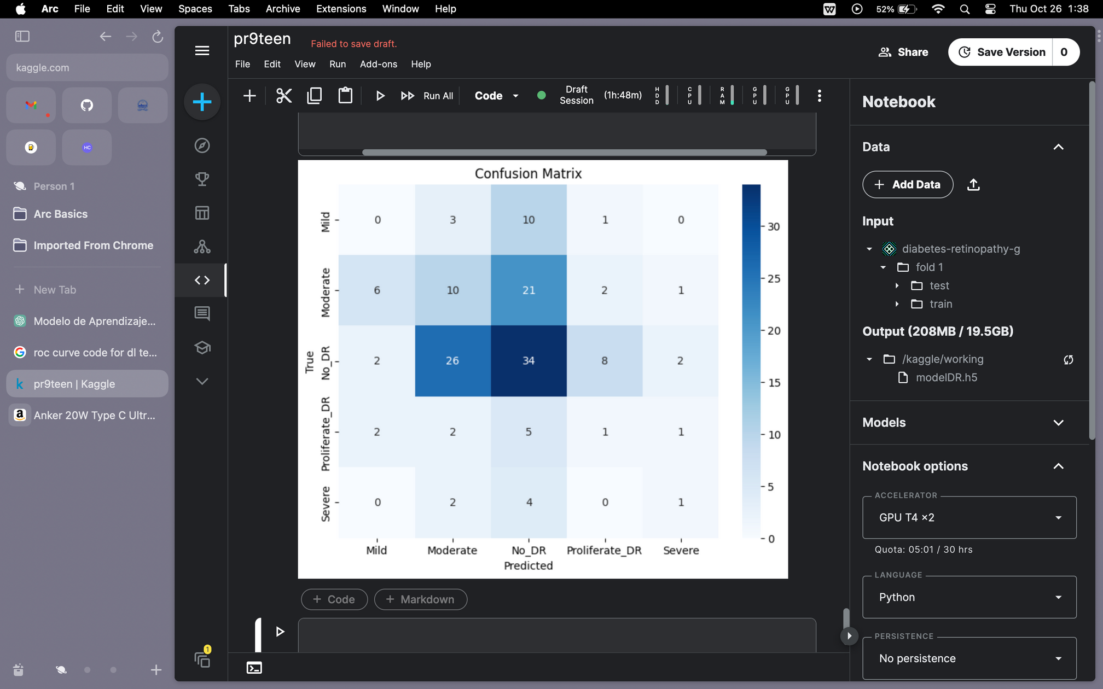
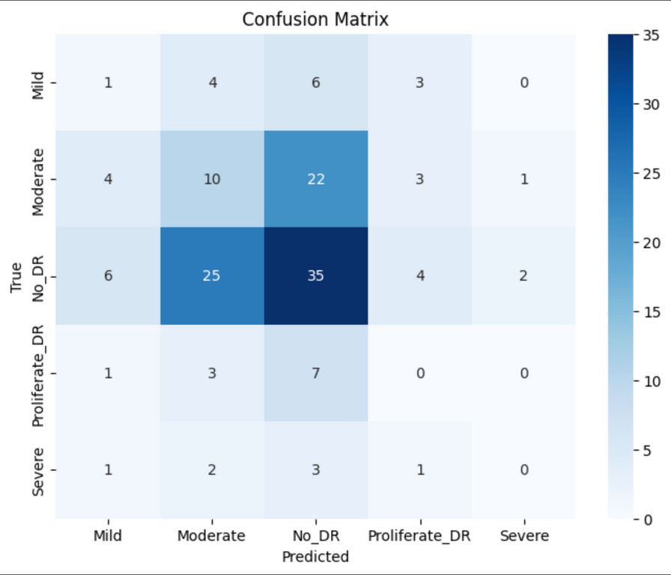
RESULT AND DISCUSSION
Batch size = 10
Batch size = 30
Confusion Matrix

Slide 37
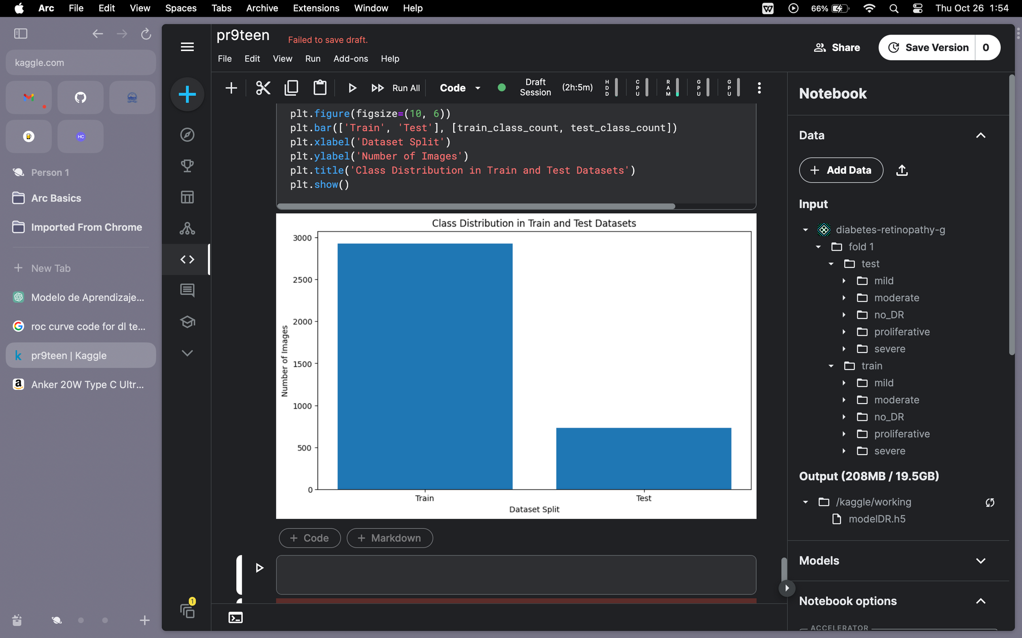
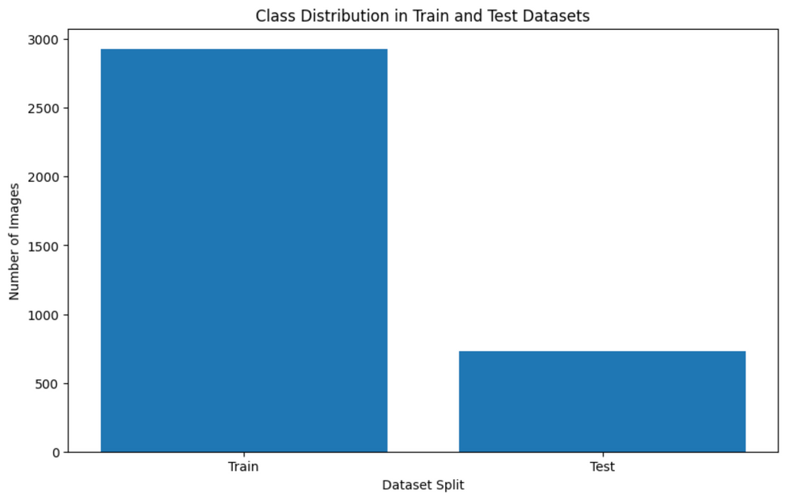
RESULT AND DISCUSSION
Batch size = 10
Batch size = 30
Data Split bar graph

Slide 38
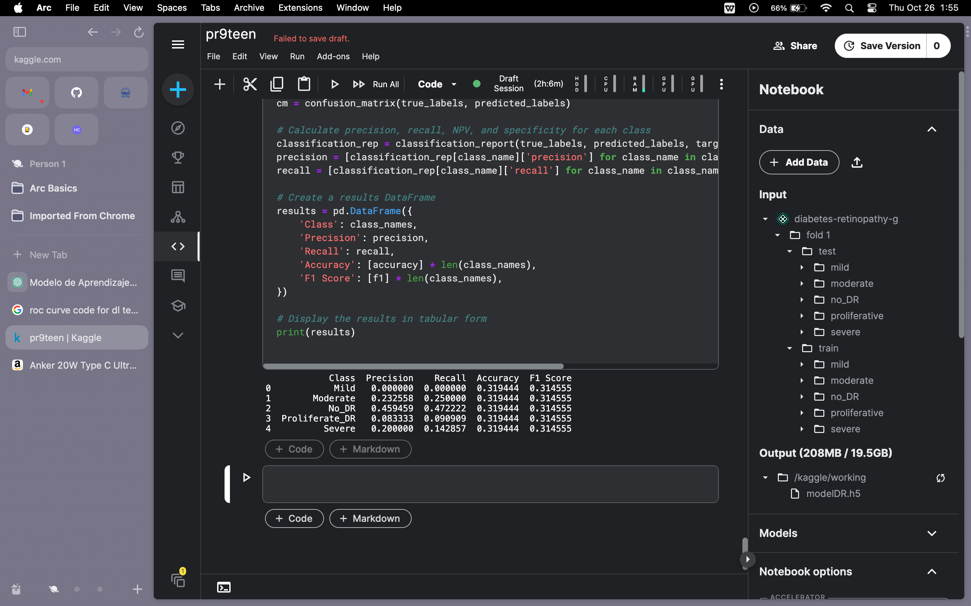
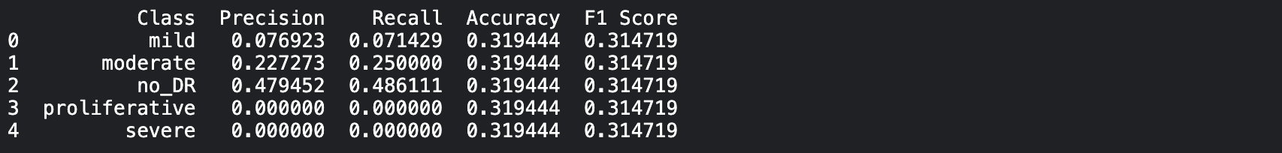
RESULT AND DISCUSSION
Batch size = 10
Batch size = 30
Result Tabular Form

Slide 39
Future Enhancement
This was just our Phase - I of project where:
We tried different filter on dataset
We found and tried different deep learning models
We played with learning rate to find the suitable one
We tried different variations in batch size and epochs
Used 5 cross validation process

Slide 40
Future Enhancement
Now for Phase-II, we’ll be :
Using 5-cross validation we’ll test all FOLDs
We will extract features of all FOLDs using Principal Component Analysis (PCA)
We will then Feature Fuse all features from different classifiers and etc.

Slide 41
CONCLUSION
In summary, our project has made significant strides in early diabetic retinopathy detection. We've addressed limitations in existing work, emphasized model interpretability, and ensured real-world applicability. With a focus on scalability, privacy compliance, and promising results, we're advancing the field and contributing to more accurate and accessible healthcare solutions.

